Slide 1
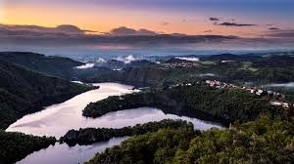
Welcome to my hometown
GARANCE PLI
LACOMBE

Slide 2
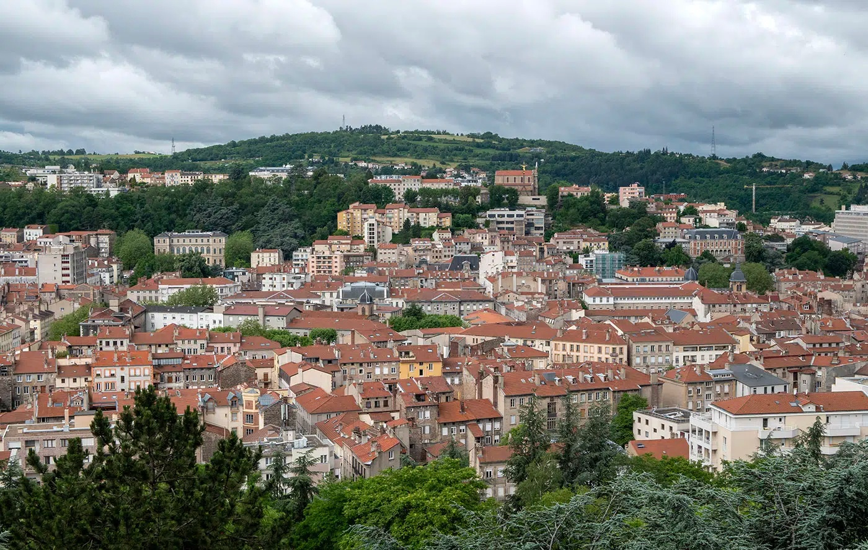
LOCATION
We from in St Etienne
St Etienne is in the south east of France
Where are we from?

Slide 3
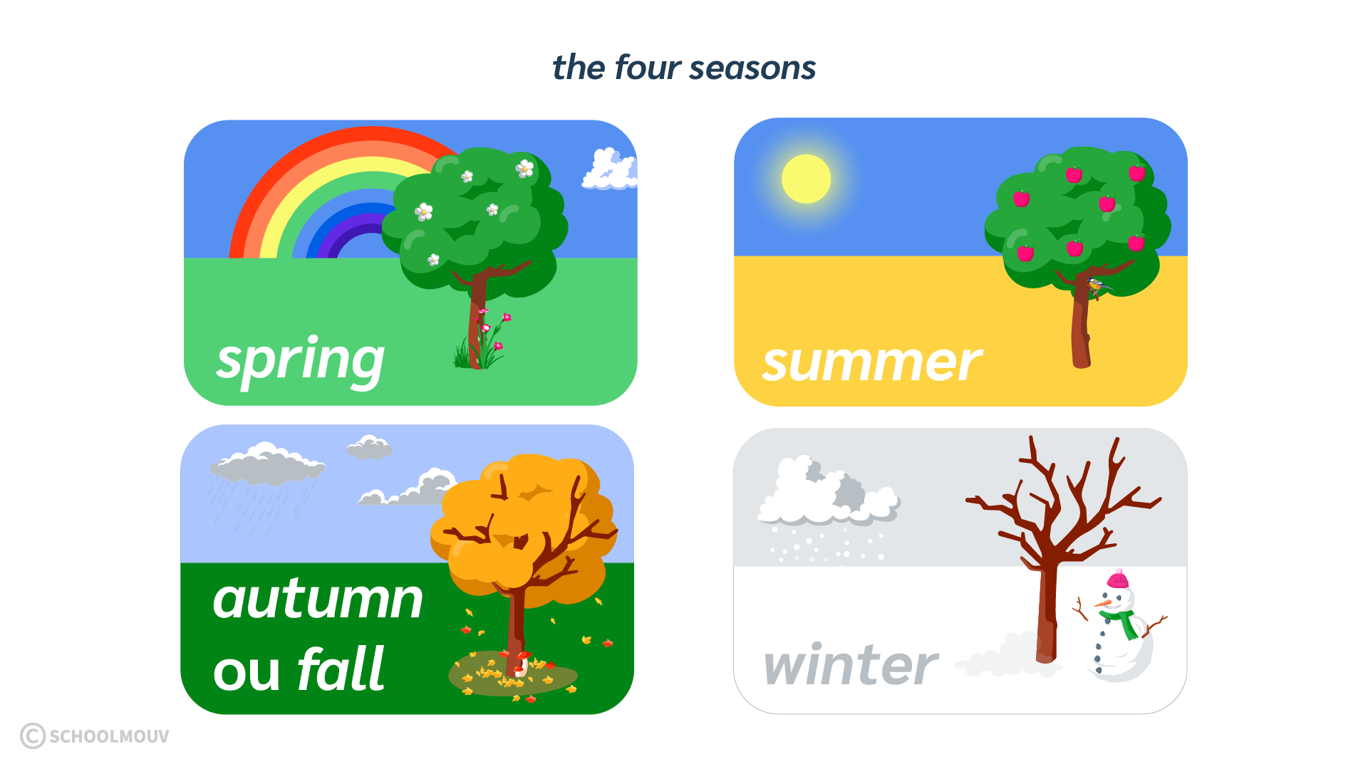
WEATHER
In summer it’s verry hot
In winter it’s verry cold, raining and snowing
In spring it’s mild and little sunny
In automn it’s windy and raining
How about the weather In
ST Etienne?

Slide 4
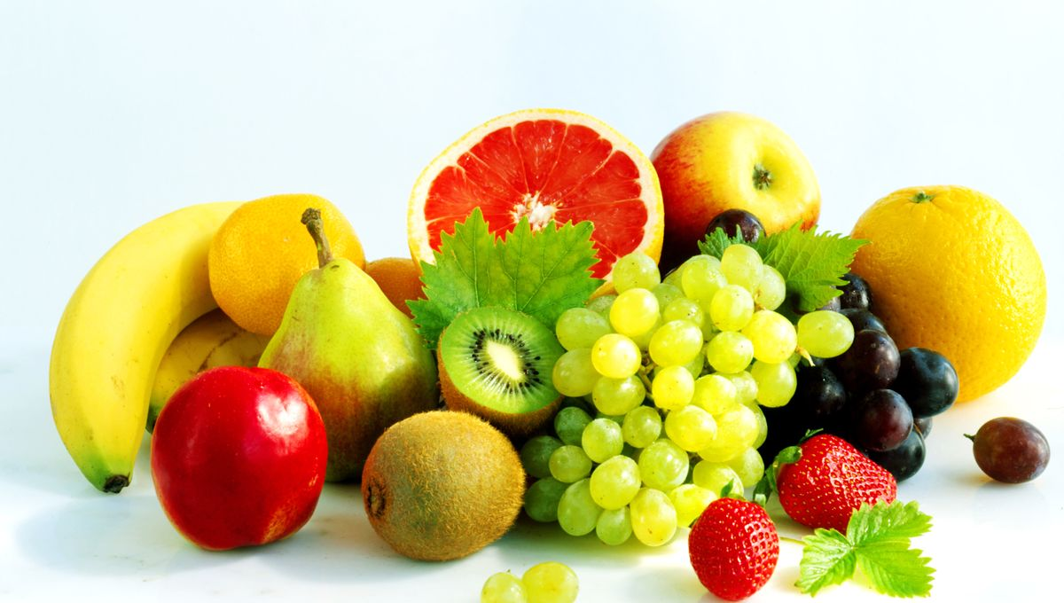
FRUITS
Strawberry
Peach
Apricot
Apple
Cherry
Raspberry
Mulberry
Melon
What fruits are available in St Etienne?

Slide 5
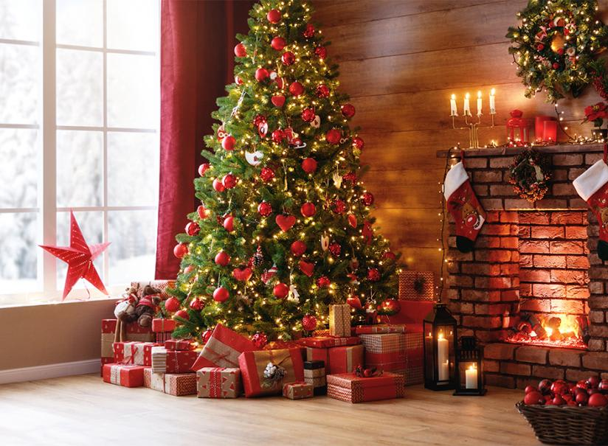
NEW YEAR
Christmas tree
Gifts
Christmas log
Family meal
Christmas decoration
Hot Chocolat
How do people celebrate New year in St Etienne?

Slide 6
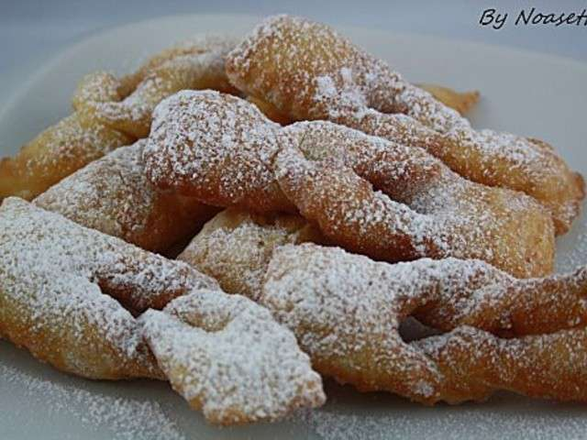
FOOD
Bosses
Grated potatoes
Fourme de Monbrison (Cheese)
What do people eat in
St Etienne?

Slide 7
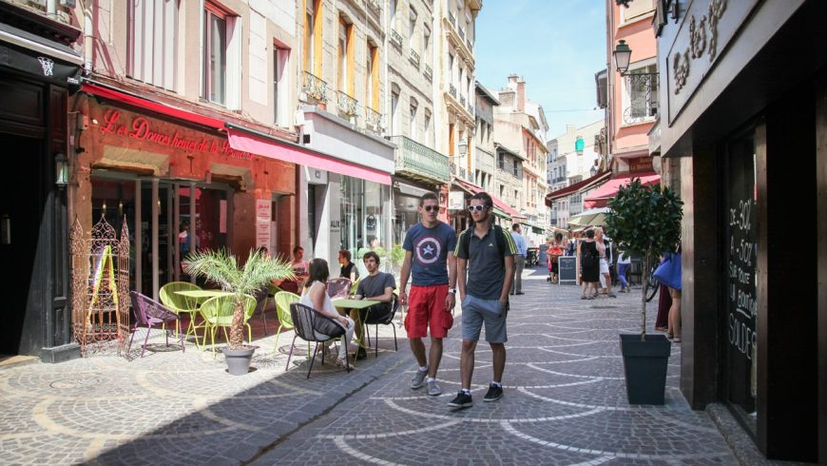
PEOPLE
Students because St Etienne is a students city
French people
Who live in
St Etienne?

Slide 8
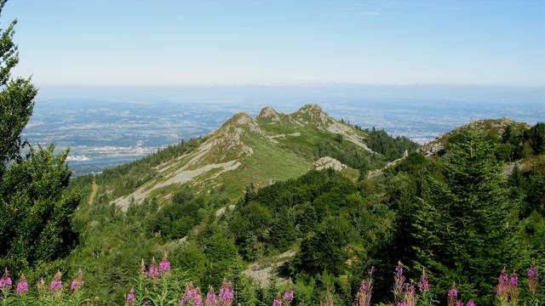
NATURE
The Pilat mountain
The Loire gorges
The mountains of Lyon
Fox
Wolf
Stork
Geese
How about the natural environment in
St Etienne?

Slide 9
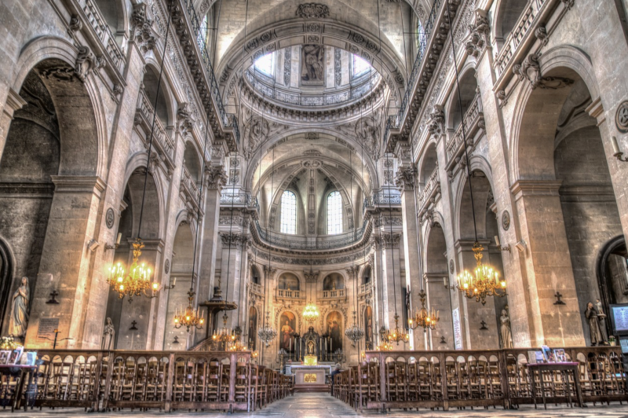
RELIGIONS
Christians : Churchs
Muslims : Mosque
No religions
Protestant :Churchs
Jew : Synagogue
Where do the people pray?
What religions is there in St Etienne?

Slide 10
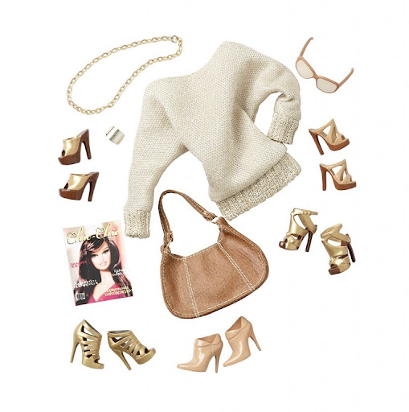
LIVING
Bag
Hat
Glasses
SunGlasses
Cap
Umbrella
What accessories
are there in St Etienne?

