Slide 1
Welcome to my hometown
Sanda Ntangulu
Et
Camille Lacombe

Slide 2
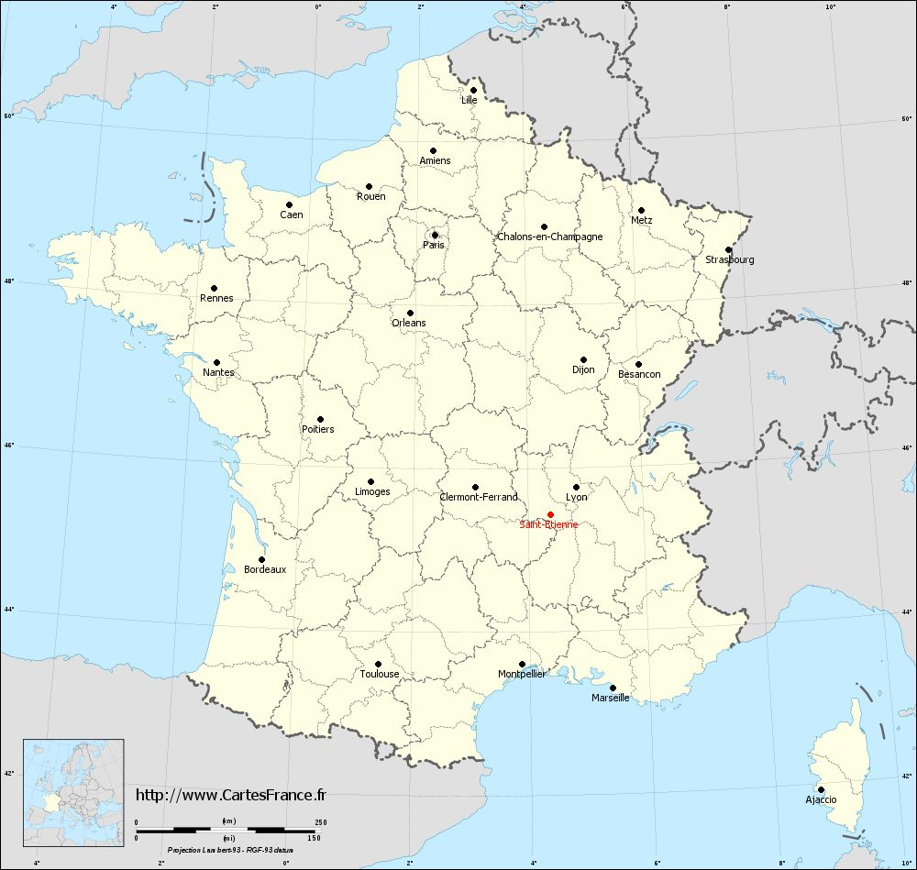
Location
We are from Saint-Etienne
Saint-Etienne is on the south-east of France.
Where are we from?

Slide 3
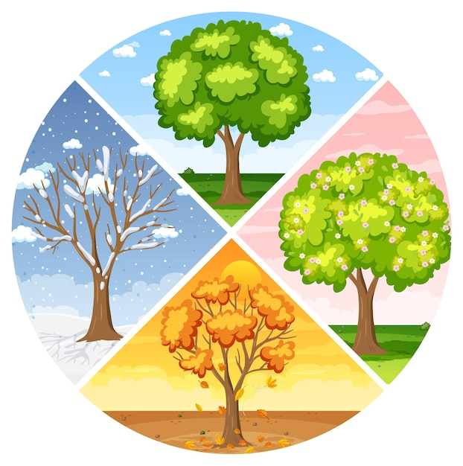
Weather
Winter with snow
Spring
Hot Summer
Autumn with falling leaves
How about the weather In Saint-Etienne?

Slide 4

Fruits
We have a lot of fruit!
Apple
Peach
Strawberries
Melon
Cherry
Kiwi
What fruits are available in Saint-Etienne?

Slide 5

New year
With a party
With our friends and family
We drink champagne
We eat a good meal
How do people celebrate New year in Saint-Etienne?

Slide 6
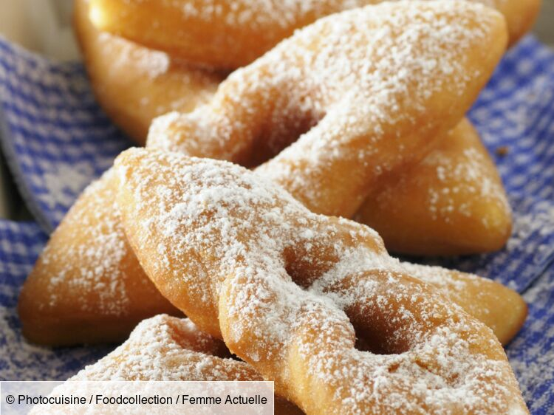
Food
A potato gratée
Cheese fourme de montbrison
Bugnes
What do people eat in Saint-Etienne?

Slide 7
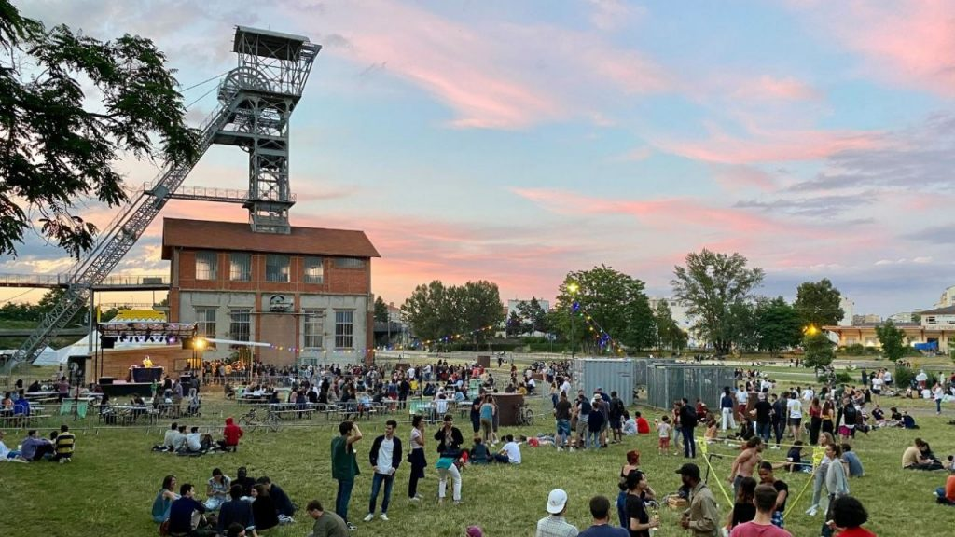
People
Stéphanois(es)
Lyonnais(es)
Students
Who live in Saint-Etienne?

Slide 8
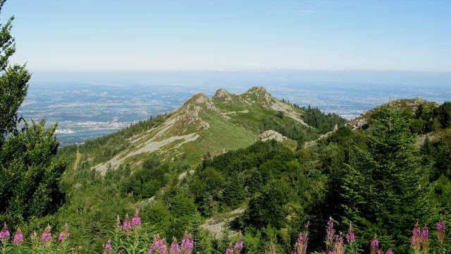
Nature
Lot of greenery
Pilat mountain
The mountains of Lyon
Parc of Montaud
The bois d’Avaize
How about the natural environment in Saint-Etienne?

Slide 9
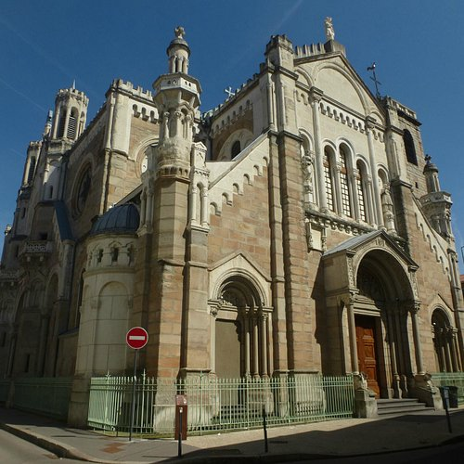
Religion
Temple (Protestants)
Church (Christians)
Mosques (Muslims)
Synagogues (Jewish)
Where do the people pray?
What do the people do when they pray?

Slide 10

Living
Football (As Saint-Etienne)
Glasses
Sun glasses

