Slide 1
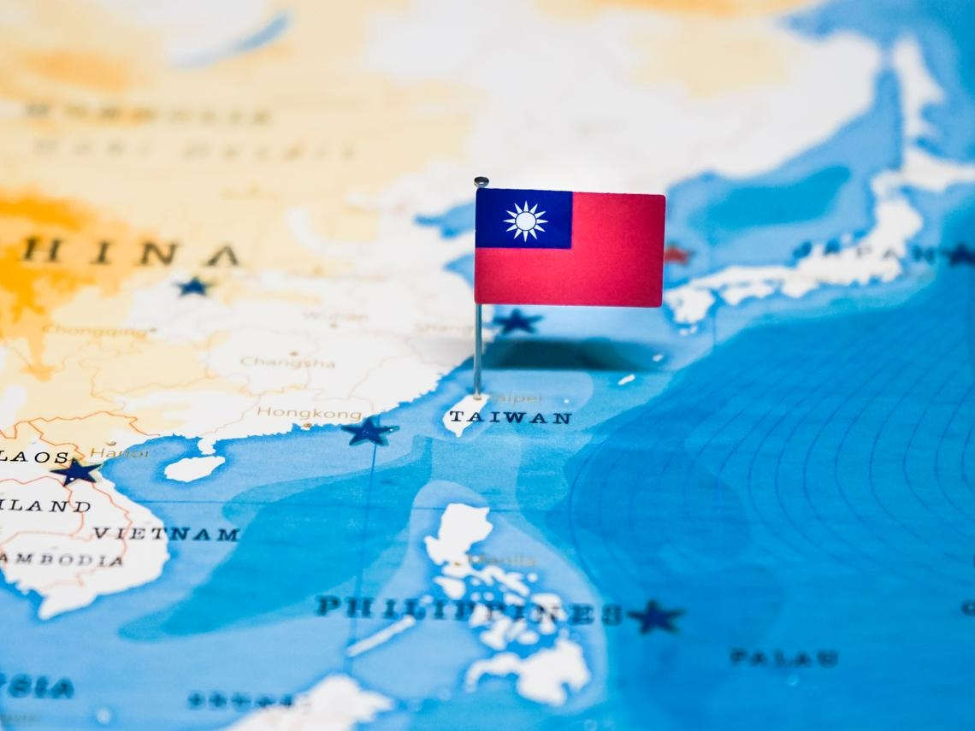
Welcome to my hometown
Taiwan

Slide 2
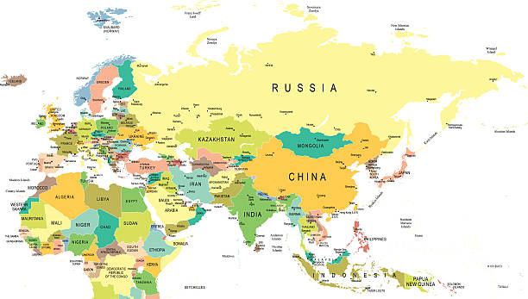
location
We are from Taiwan
Taiwan is on the east of Asia.
Where are we from?

Slide 3
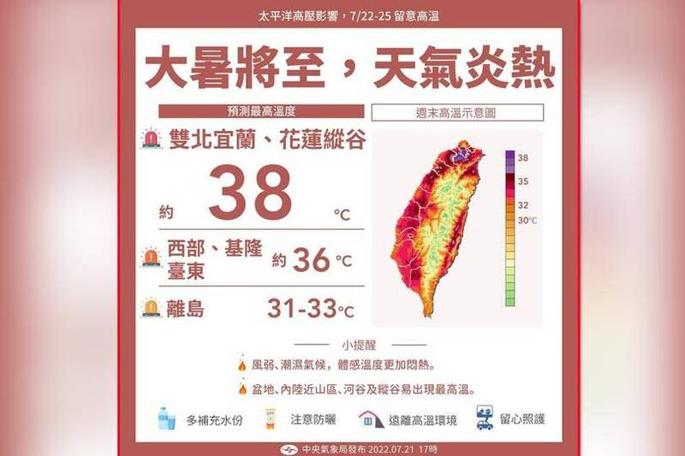
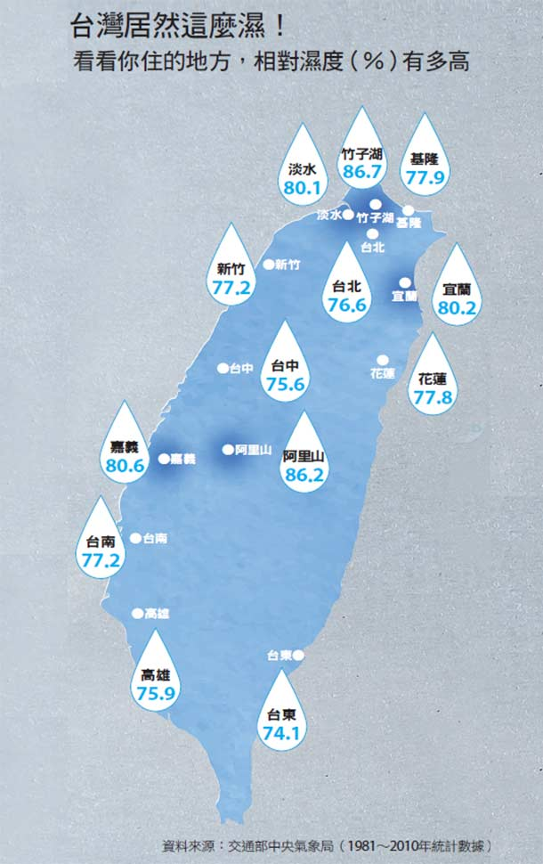
weather
It is Windy
It is humid
It is hot

Slide 4
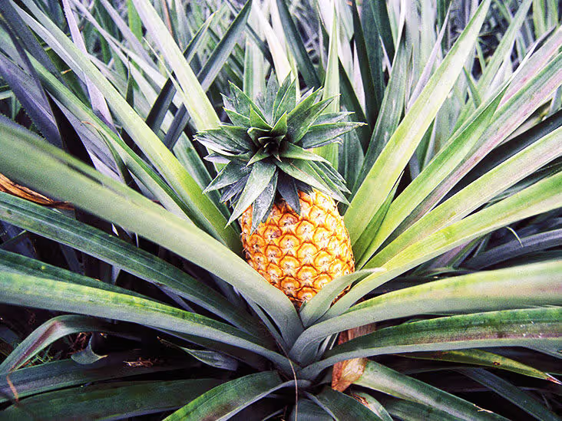
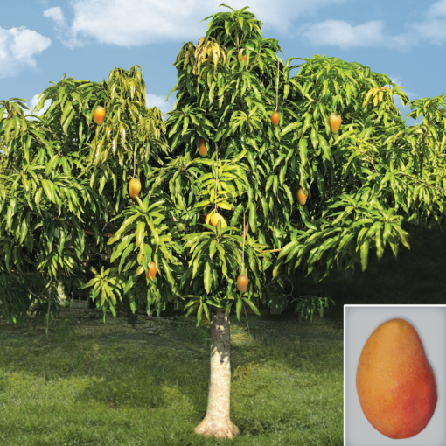
fruit
We have mangos !
We have pinapples!

Slide 5
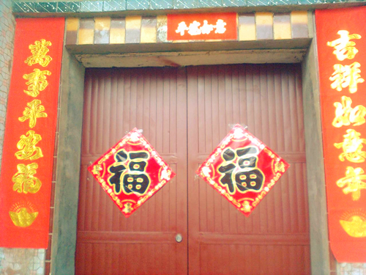
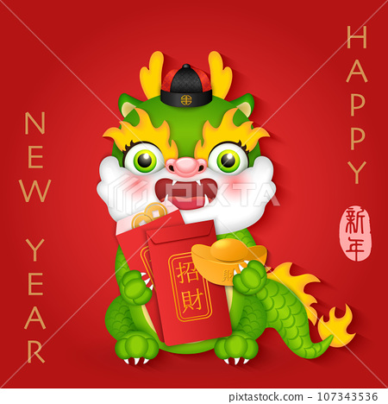
New year
We send red envelops to others.
We stick Spring couplets on the wall.

Slide 6
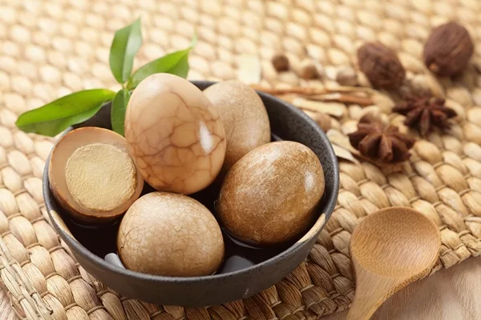
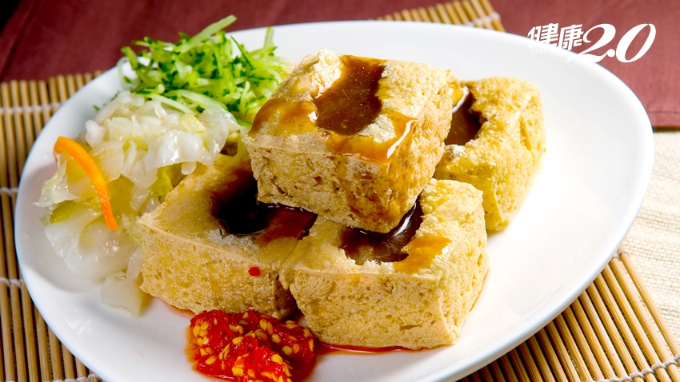
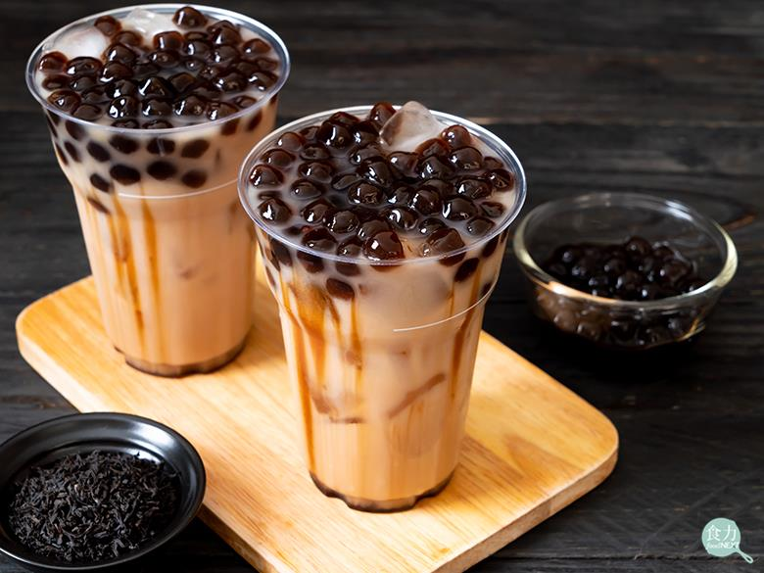
food
stinky tofu
bubble tea
tea eggs)

Slide 7
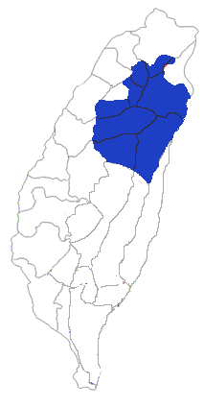
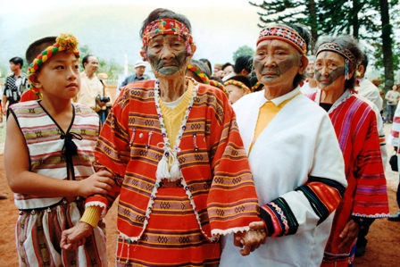
People
Taiwanese and Hakka live in Taiwan
Aboriginal people called Atayal live in the mountains.

Slide 8
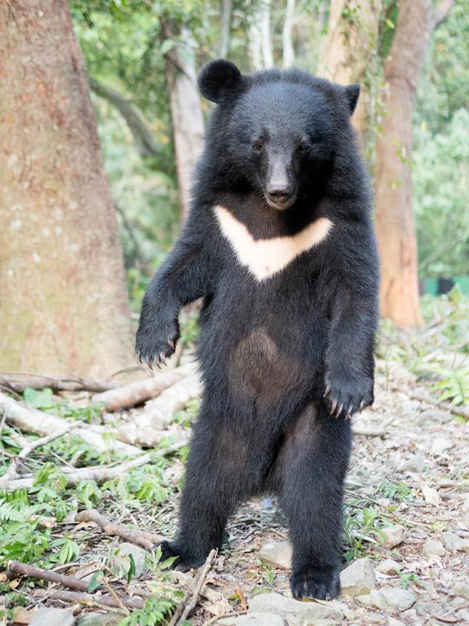
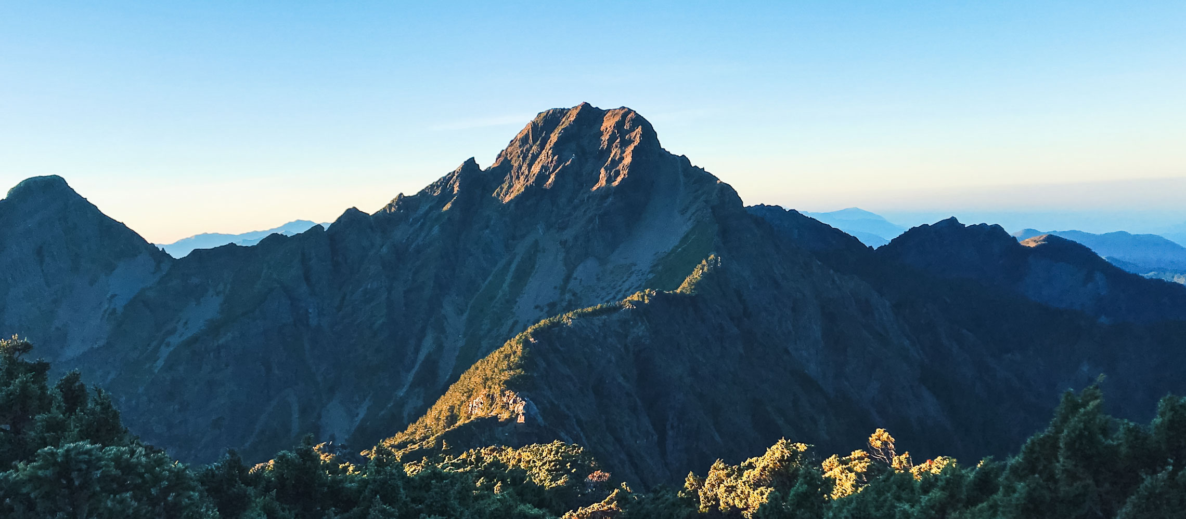
Nature
The highest mountain in Taiwan is Mountain Yusan
The biggest wild animal in Taiwan is black bears

Slide 9
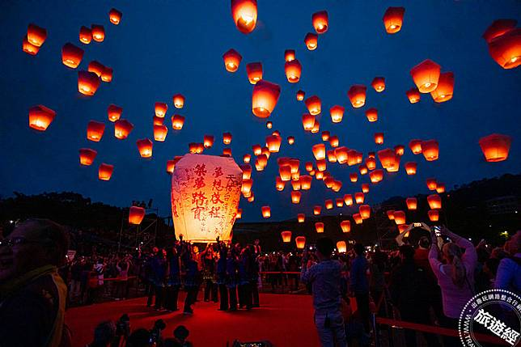
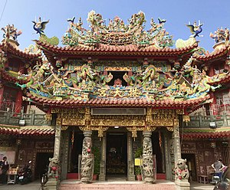
religion
We go to Temple for pray.
We set off lantern for luck.
Where do the people pray?
Why do the people pray?

Slide 10
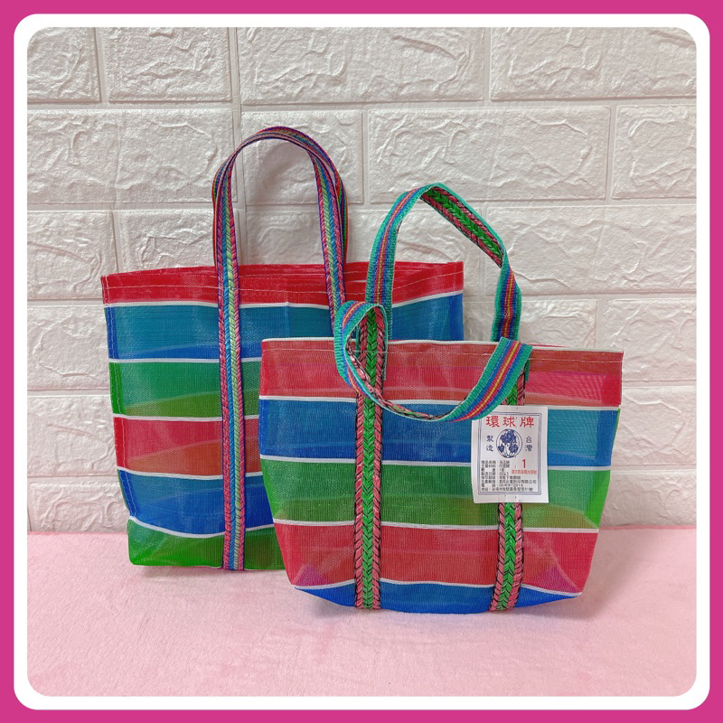
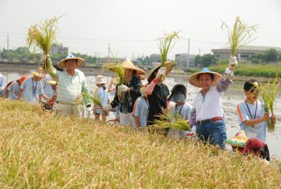
living in the countryside
We have「 Grandma bag」.
We wear bamboo hat.

